Slide 1
Team Wind: Group research project for developing and experimenting biomedical images analysis for Covid19
Created by: Leiyi Gao, Steven Liao, Miho Shimizu, Alexander Shirazi,
Tyler Heslop, Sungho Lee.
Present by: Leiyi Gao & Tyler Heslop

Slide 2
Summary/Outline
Develop a 3D diagnosis system for Covid19(lung) biomedical images.
Our system includes:
Segmentation:
Using the process to detect boundaries of anatomical structures of 3D covid19 lung images.
Divide the infected region into a group and showing the result.
Registration:
Using two sets of covid19 images(Infected with different stage and healthy lung) to align the images for analysis.
Visualized the difference between covid19 infected lung and the healthy lung.
Quantification:
Experimenting different number/inputs inside of code to find the best value.
Validating our Registration result visually/quantitatively.
Compare different segmentation/registrations algorithms to determine which one perform best for the used data.

Slide 3
Algorithms we implemented:
Segmentation:
Region Growing Algorithm-Pixel based image segmentation method since it involves the selection of initial seed. It examines neighboring pixels of initial seed points and determines whether the pixel neighbors should be added to the region.
Watershed Algorithm-It is a transformation defined on a grayscale image and separates different objects in an image. This allows for counting the objects or for further analysis of the separated objects.
Registration:
Demon Algorithm-It is used for non-rigid registration of 3D medical images. This algorithm is based on intuitive ideas about image registration, it could be slow and not accurate.
Intensity Based Algorithm-It is an iterative process, and it requires that user specify a pair of images, a metric, an optimizer, and a transformation type. The metric defines the image similarity metric for evaluating the accuracy of the registration.

Slide 4
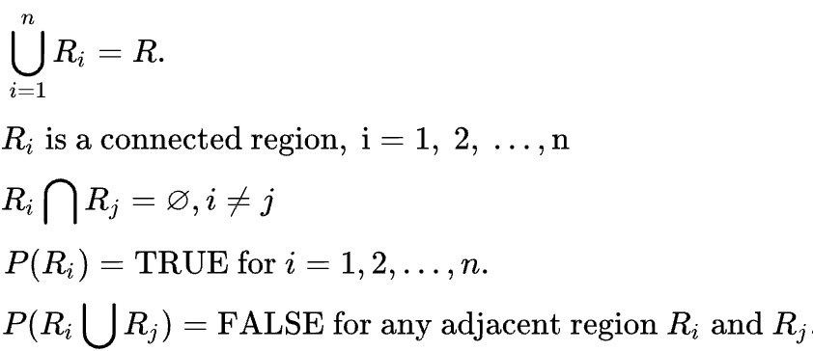
Segmentation Region Growing Algorithm:
The main goal is to partition an image into regions. Some segmentation methods such as thresholding achieve this goal by looking for the boundaries between regions based on discontinuities in grayscale or color properties. Region-based segmentation is a technique for determining the region directly. The basic formulation is:
Every

Slide 5
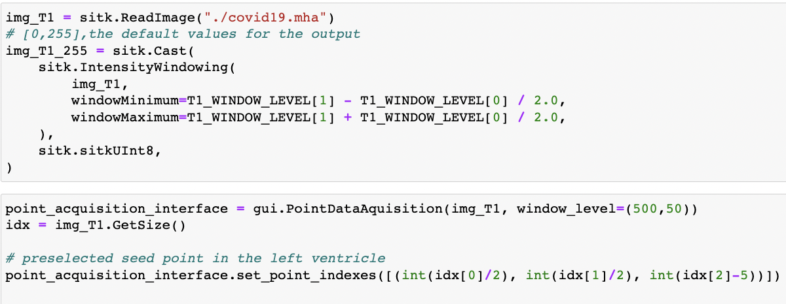
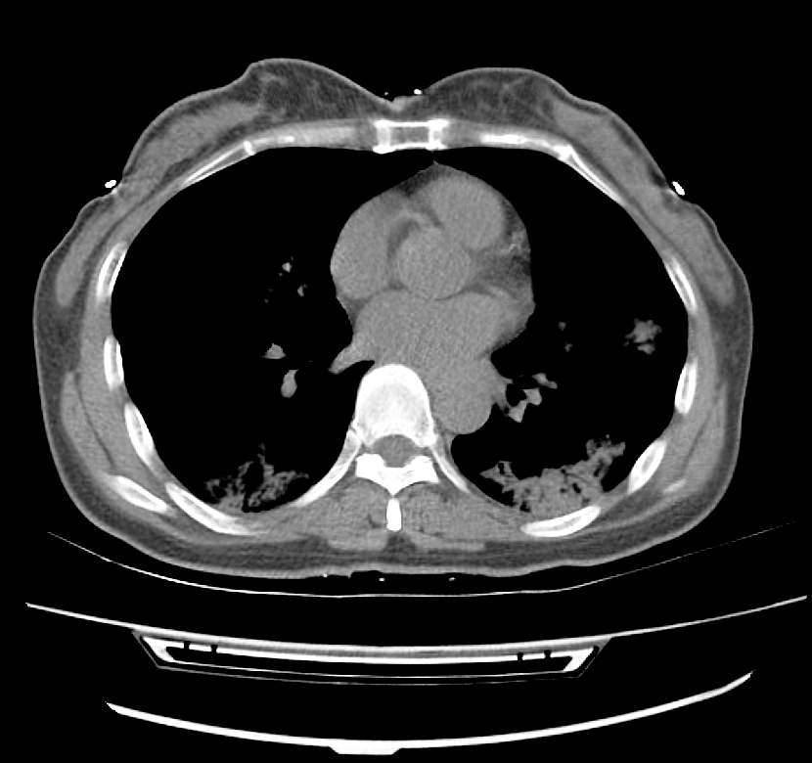
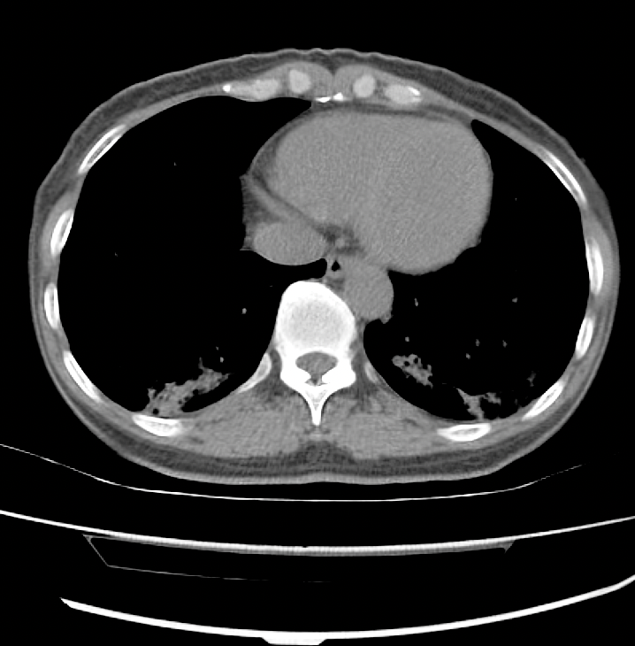
Region Growing Algorithm Continued
Read the data and select the seed point:
Output:

Slide 6
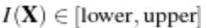
Region Growing Algorithm Continued
Connected Threshold: A simple criterion for including pixels in a growing region is to evaluate intensity value inside a specific interval. Lower and upper threshold values should be provided. The region-growing algorithm includes those pixels whose intensities are inside the interval.
We now set the lower and upper threshold values. Any pixel whose value is between lower-Threshold and upper-Threshold will be included in the region, and any pixel whose value is outside will be excluded. Setting these values too close together will be too restrictive for the region to grow; setting them too far apart will cause the region to engulf the image.

Slide 7
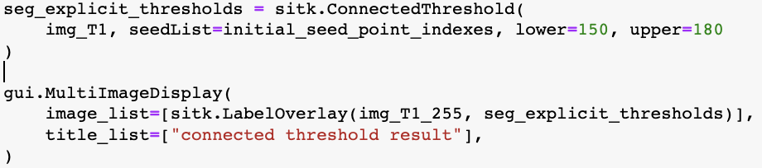
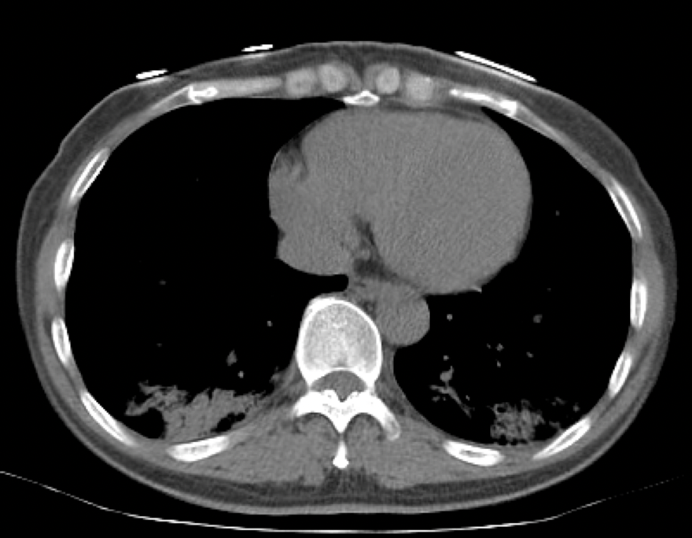
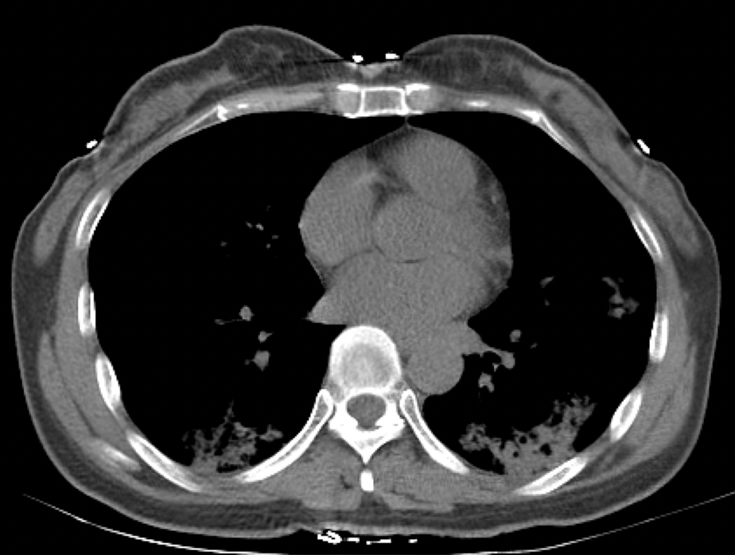
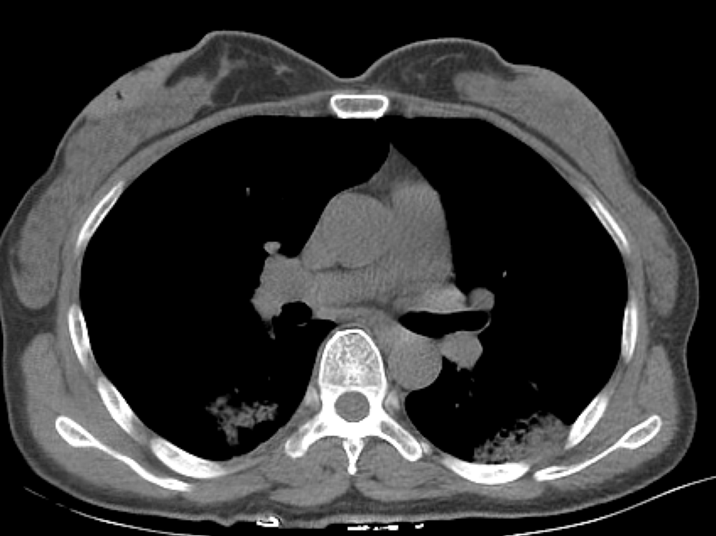
Region Growing Algorithm Continued
Connected Threshold:
Output:

Slide 8
Region Growing Algorithm Continued
Confidence Connected: This filter extracts a connected set of pixels whose pixel intensities are consistent with the pixel statistics of a seed point. The mean and variance across a neighborhood (8-connected, 26-connected, etc.) are calculated for a seed point. Then pixels connected to this seed point whose values are within the confidence interval for the seed point are grouped.
The width of the confidence interval is controlled by the "Multiplier" variable (the confidence interval is the mean plus or minus the "Multiplier" times the standard deviation). If the intensity variations across a segment were gaussian, a "Multiplier" setting of 2.5 would define a confidence interval wide enough to capture 99% of samples in the segment.

Slide 9
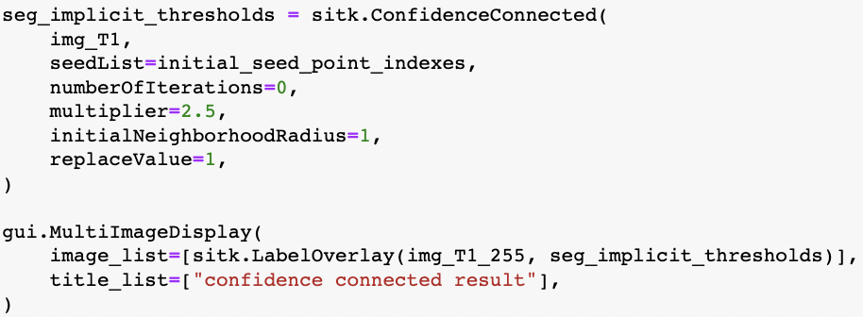
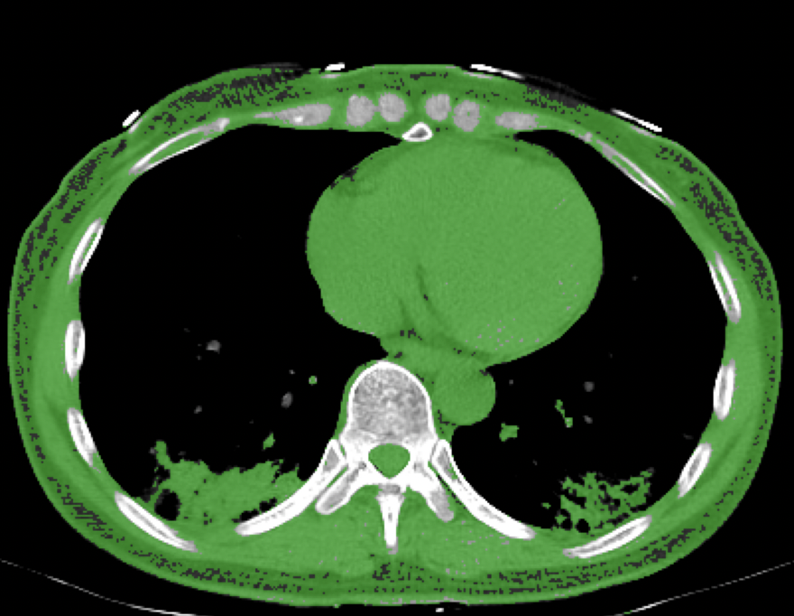
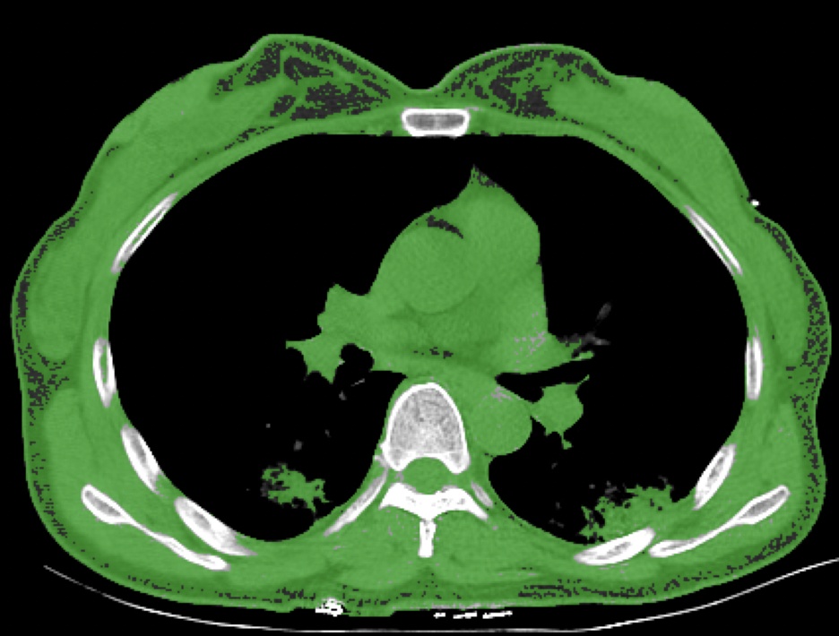
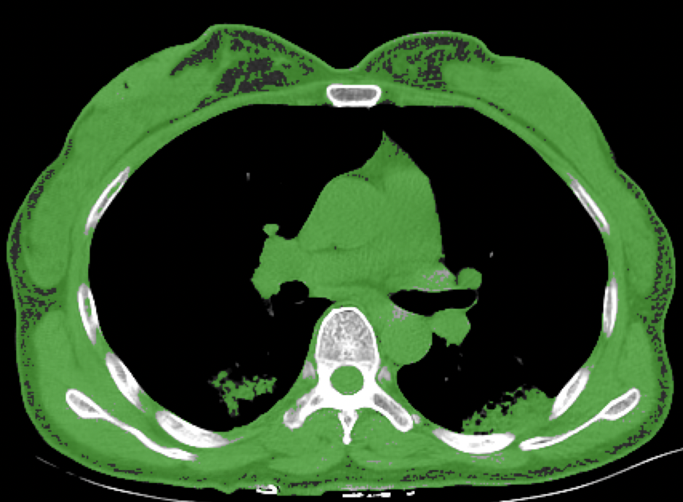
Region Growing Algorithm Continued
Connected Threshold:
Output:

Slide 10
Region Growing Algorithm Continued
Vector Confidence Connected: This filter extracts a connected set of pixels whose pixel intensities are consistent with the pixel statistics of a seed point. The mean and variance across a neighborhood (8-connected, 26-connected, etc.) are calculated for a seed point. Then pixels connected to this seed point whose values are within the confidence interval for the seed point are grouped. The width of the confidence interval is controlled by the "Multiplier" variable (the confidence interval is the mean plus or minus the "Multiplier" times the standard deviation). If the intensity variations across a segment were gaussian, a "Multiplier" setting of 2.5 would define a confidence interval wide enough to capture 99% of samples in the segment.
After this initial segmentation is calculated, the mean and variance are re-calculated. All the pixels in the previous segmentation are used to calculate the mean the standard deviation (as opposed to using the pixels in the neighborhood of the seed point). The segmentation is then recalculated using these refined estimates for the mean and variance of the pixel values. This process is repeated for the specified number of iterations. Setting the "NumberOfIterations" to zero stops the algorithm after the initial segmentation from the seed point.

Slide 11
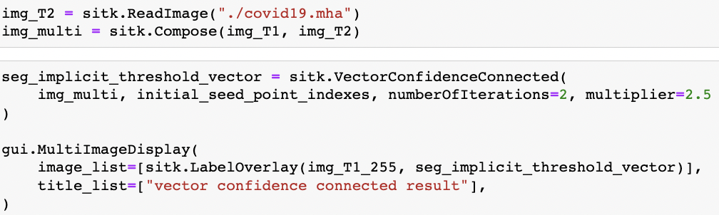
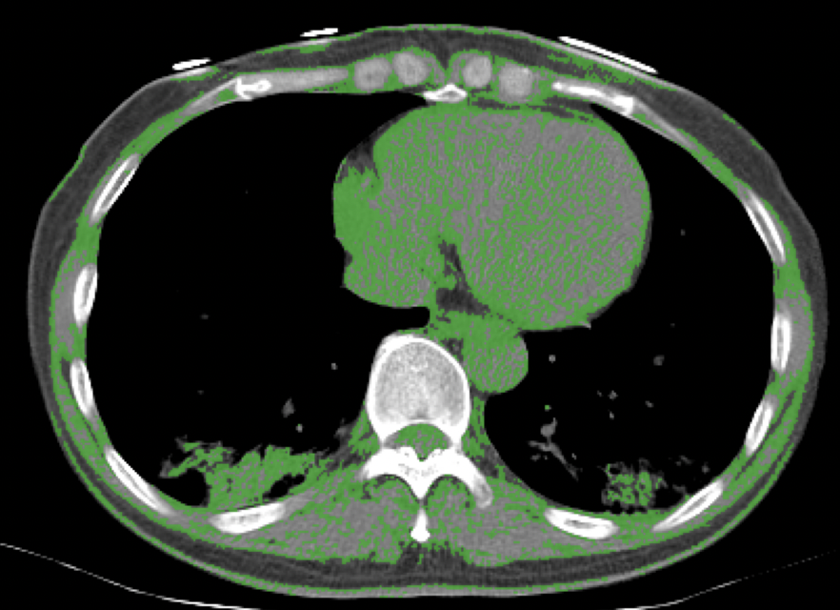
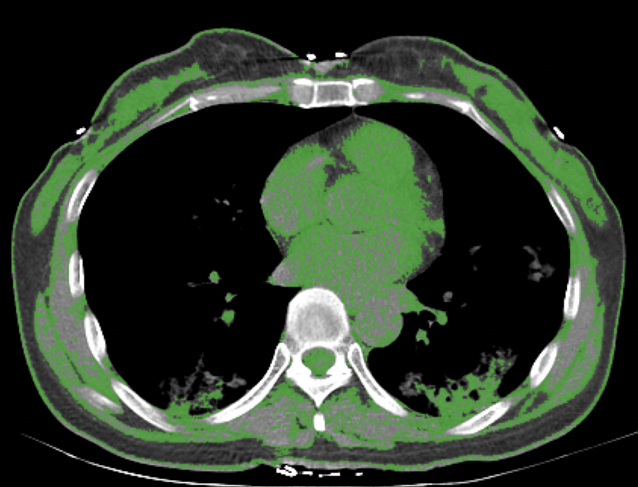
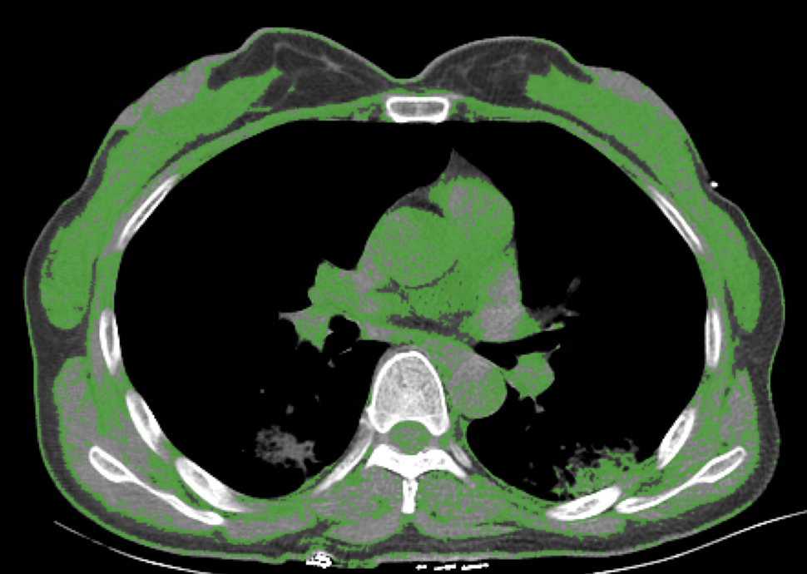
Region Growing Algorithm Continued
Vector Confidence Connected:
Output:

Slide 12
Segmentation Watershed Algorithm:
Watershed algorithm is based on extracting sure background and foreground and then using markers will make watershed run and detect the exact boundaries. This algorithm generally helps in detecting touching and overlapping objects in image.
During the successive flooding of the gray value relief, watersheds with adjacent catchment basins are constructed. This flooding process is performed on the gradient image, the basins should emerge along the edges.

Slide 13
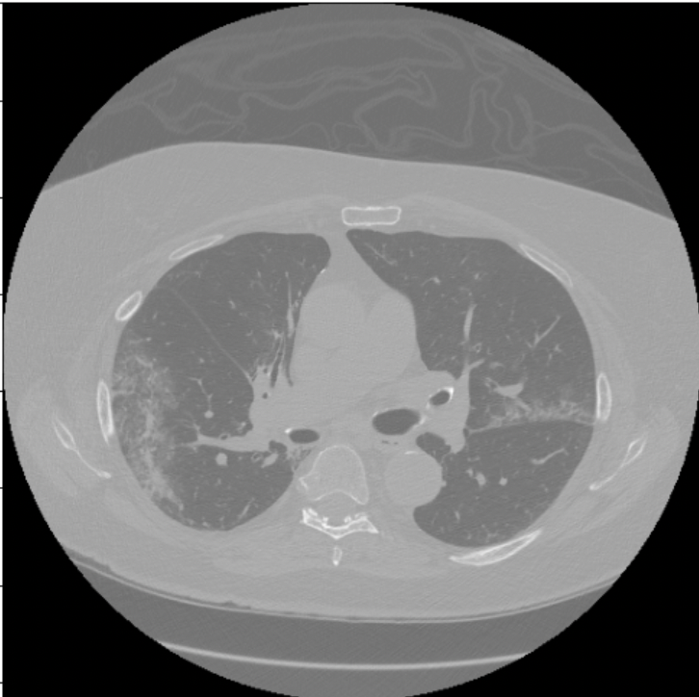
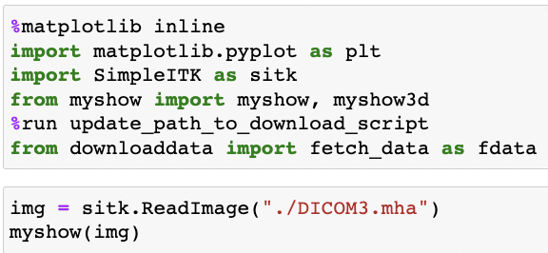
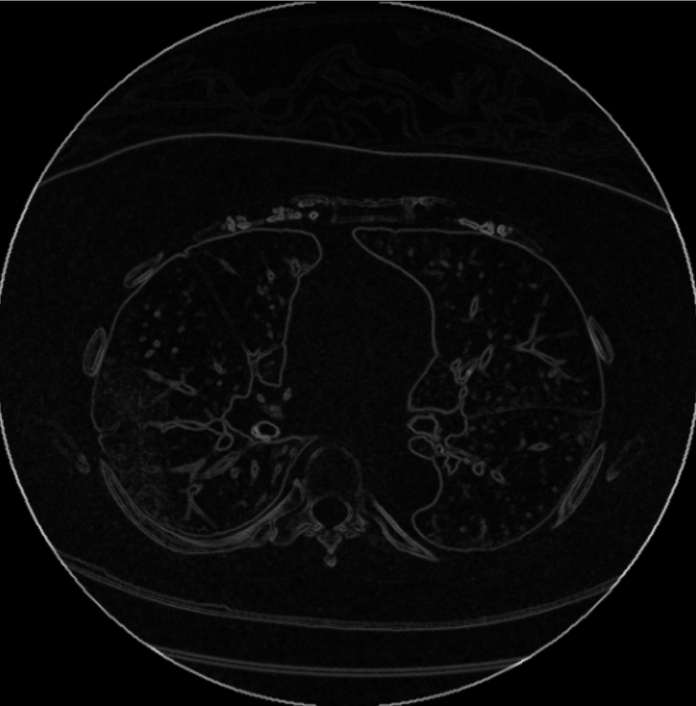
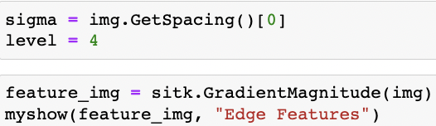
Watershed Algorithm Continued
Original file :
Read data: Output:
Gradient Watersheds Segmentation:
Output:

Slide 14
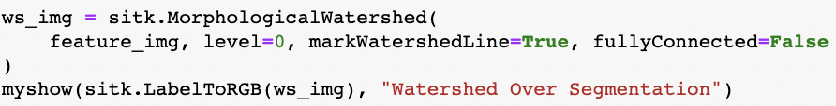
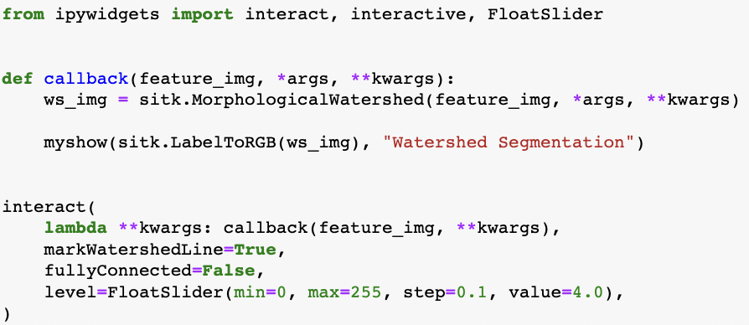
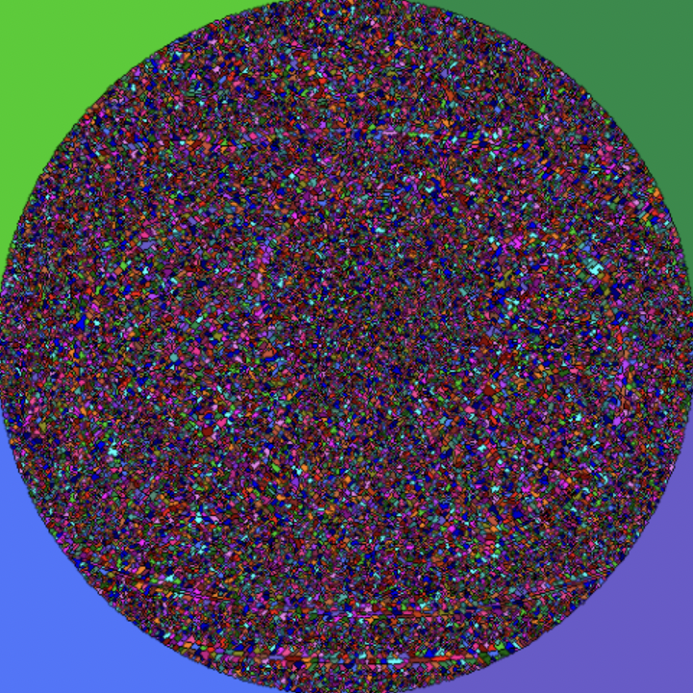
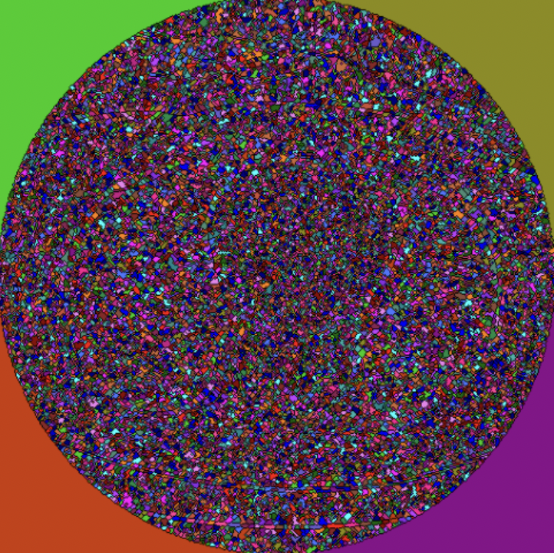
Watershed Algorithm Continued:
Gradient Watersheds Segmentation:
Output:

Slide 15
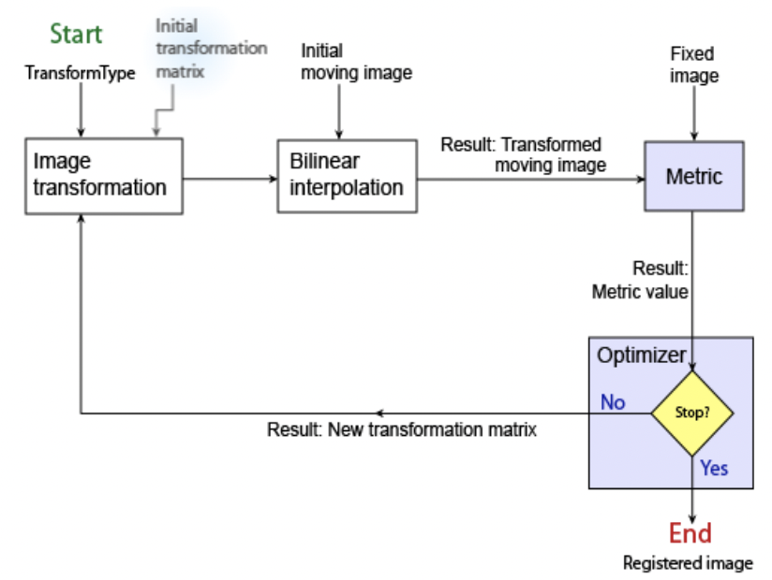
Registration Intensity Based:
It is an iterative process, and it requires that the user specify a pair of images, a metric, an optimizer, and a transformation type. The metric defines the image similarity metric for evaluating the accuracy of the registration.
Steps:

Slide 16
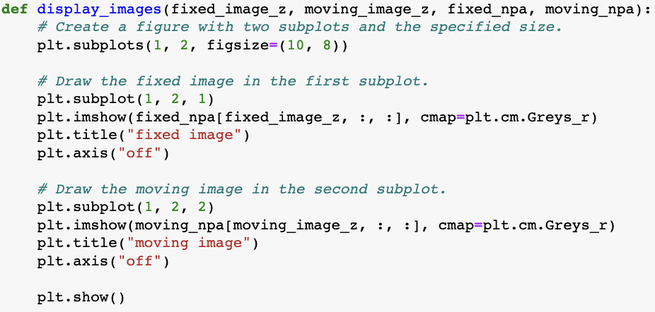
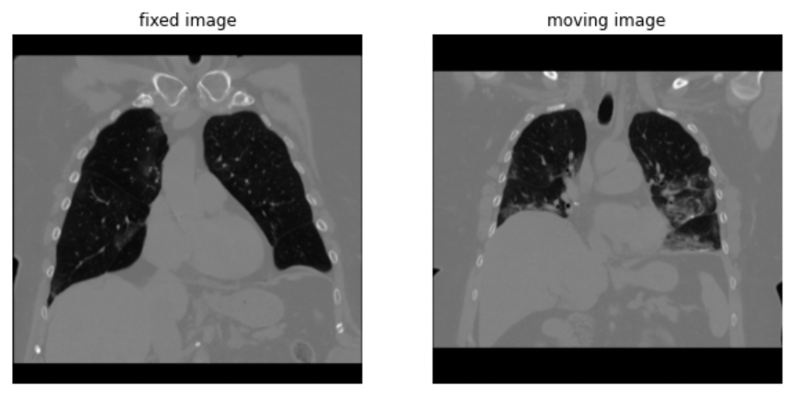
Intensity Based Continued
Usually, there are 2 sublots created. Moving and Fixed.
Output:

Slide 17
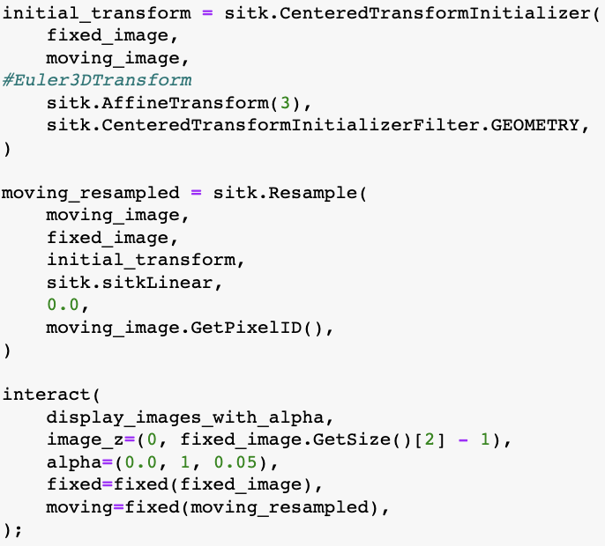
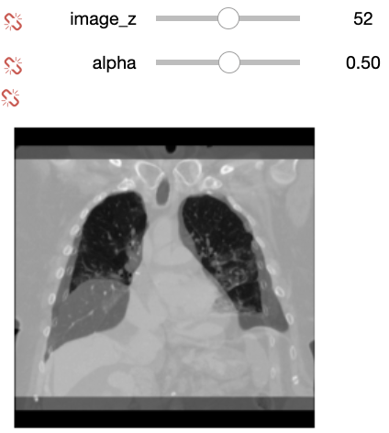
Intensity Based Continued
Then we lay them together(Euler method in our lecture):
Output:

Slide 18
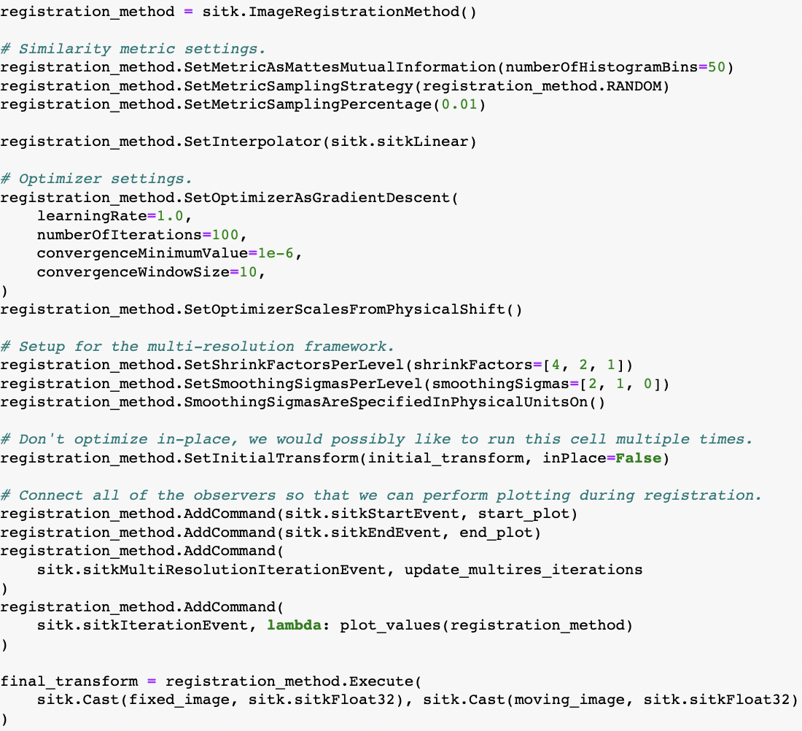
Intensity Based Continued:
We will need our metric value and optimizer’s stopping point:

Slide 19
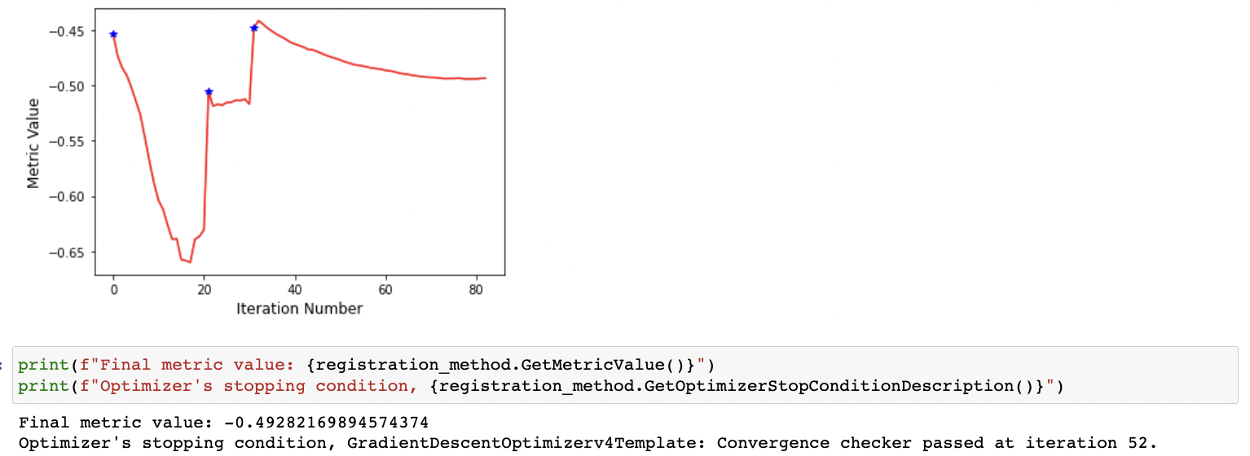
Intensity Based Continued:
Let’s see our result:
An optimizer is required to explore the parameter space of the transform in search of optimal values of the metric.
The metric will compare how well the two images match each other. Metric types are usually templated over the image types.

Slide 20
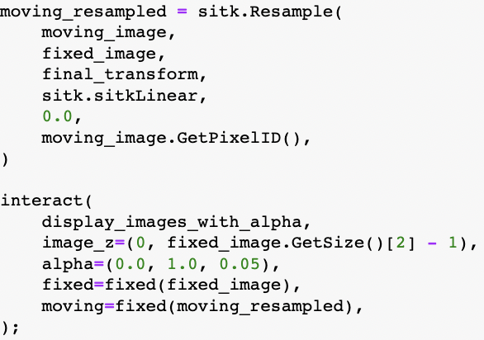

Intensity Based Continued:
Then we can get our final output:

Slide 21
Registration Demon:
It is widely used for deformable registration of images from the same imaging modality by iteratively solving the gradient constraint equation to build pixel correspondence between the reference and float images.
The algorithm itself does not solve the equation completely and it assumes that pixels move in the direction of the gradient, which is not true for most circumstances.

Slide 22

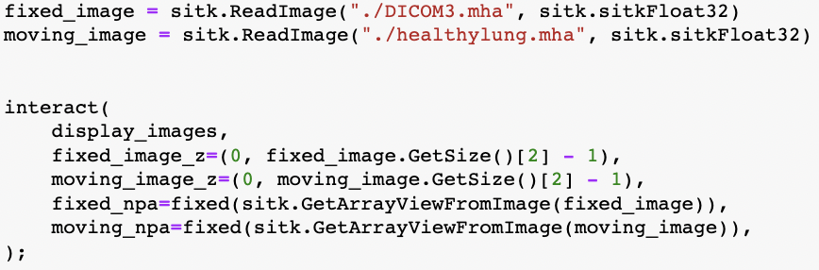
Demon Continued
Same as Intensity Based, we need fixed and moving images
Metric value and Iteration number.

Slide 23
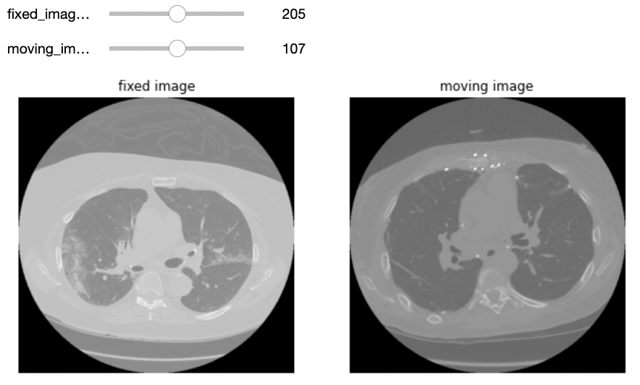
Demon Algorithm Continued
As we noticed, we used covid19-positive lung and healthy lung
Output:

Slide 24
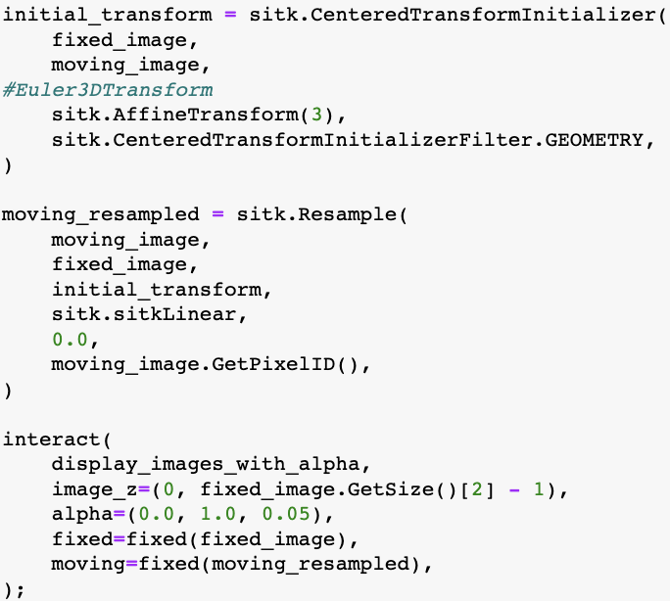
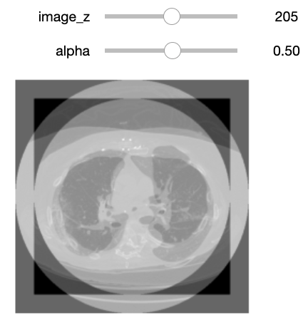
Demon Algorithm Continued
We also use Euler method
Output:

Slide 25
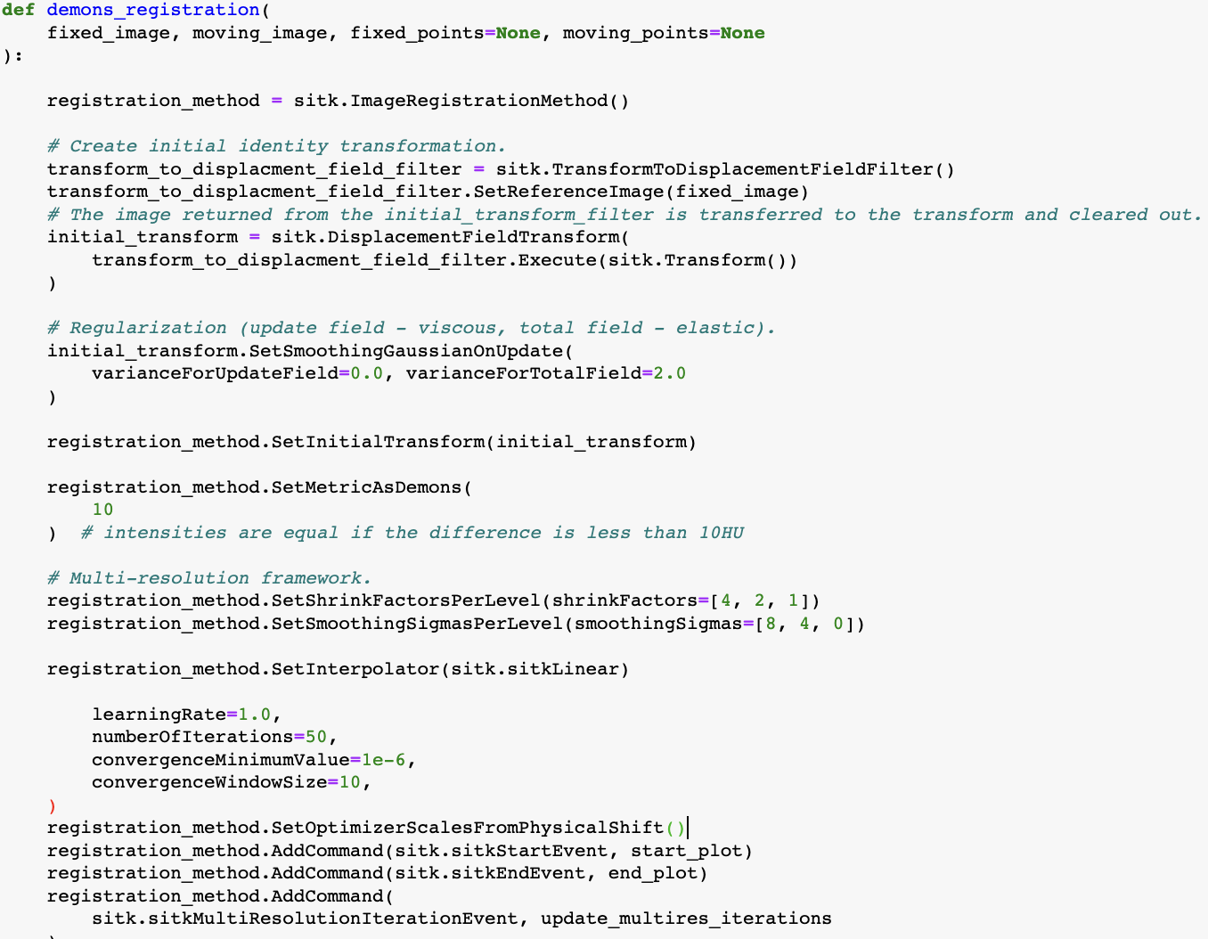
Demon Algorithm Continued
The actual Demon Method:

Slide 26
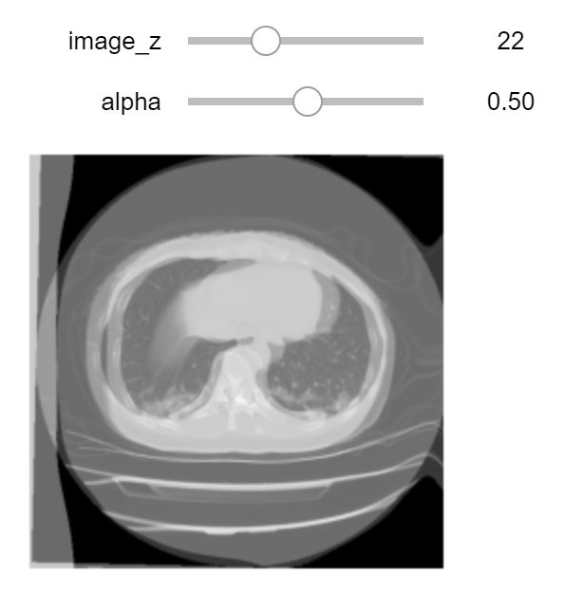
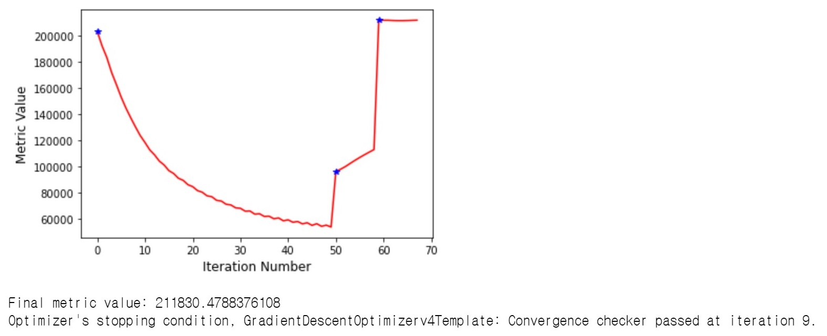
Demon Algorithm Continued:
The metric value and the output:

Slide 27
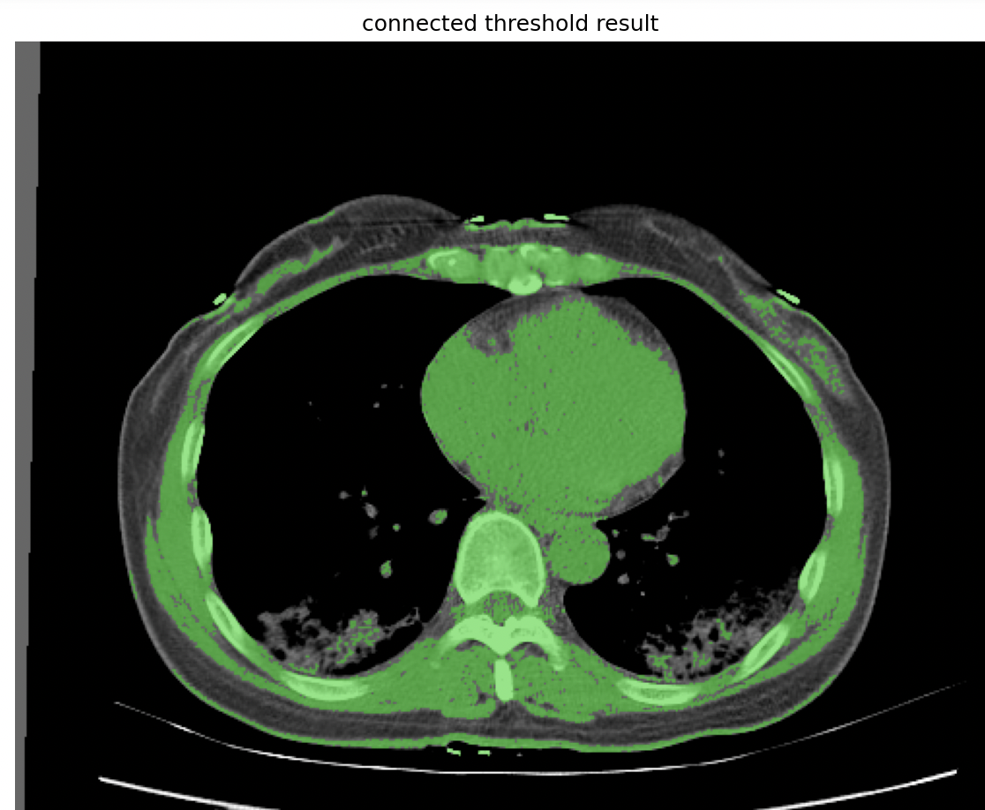
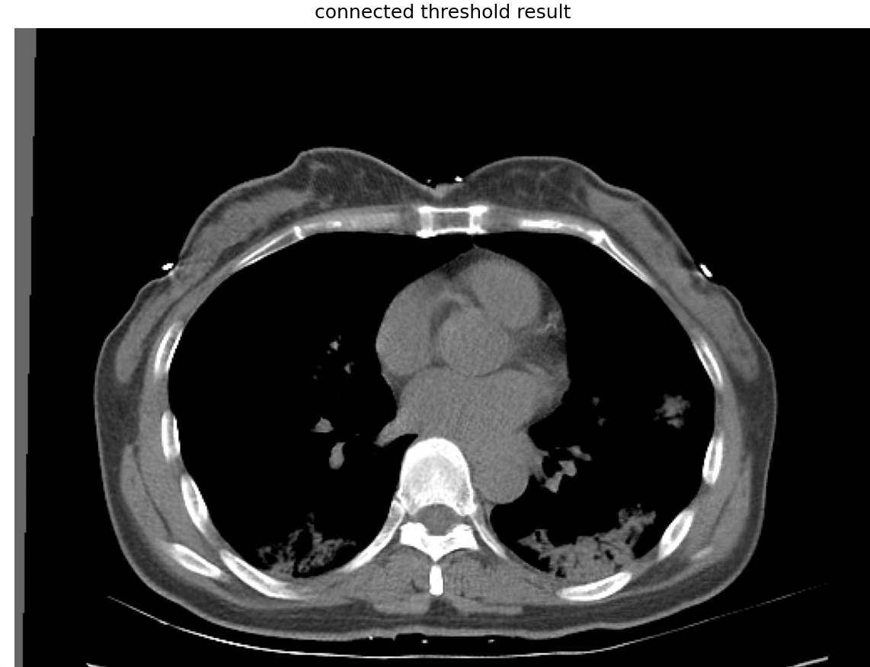
Quantification
Region Growing Segmentation
Here we show the difference with two seed index value for Connected Threshold Filter:

Slide 28
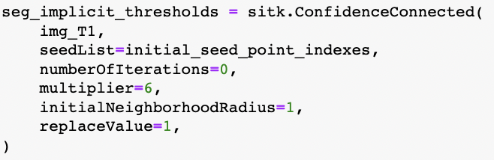
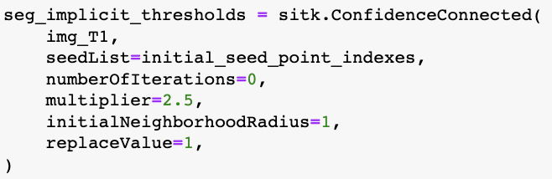
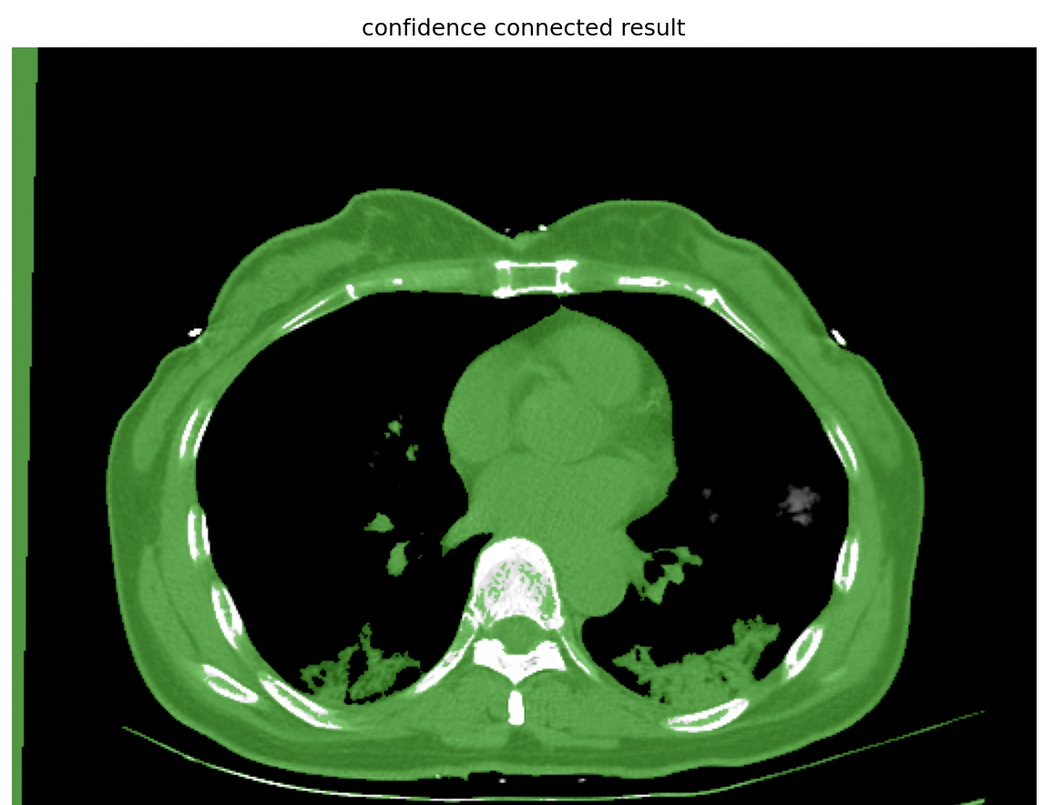
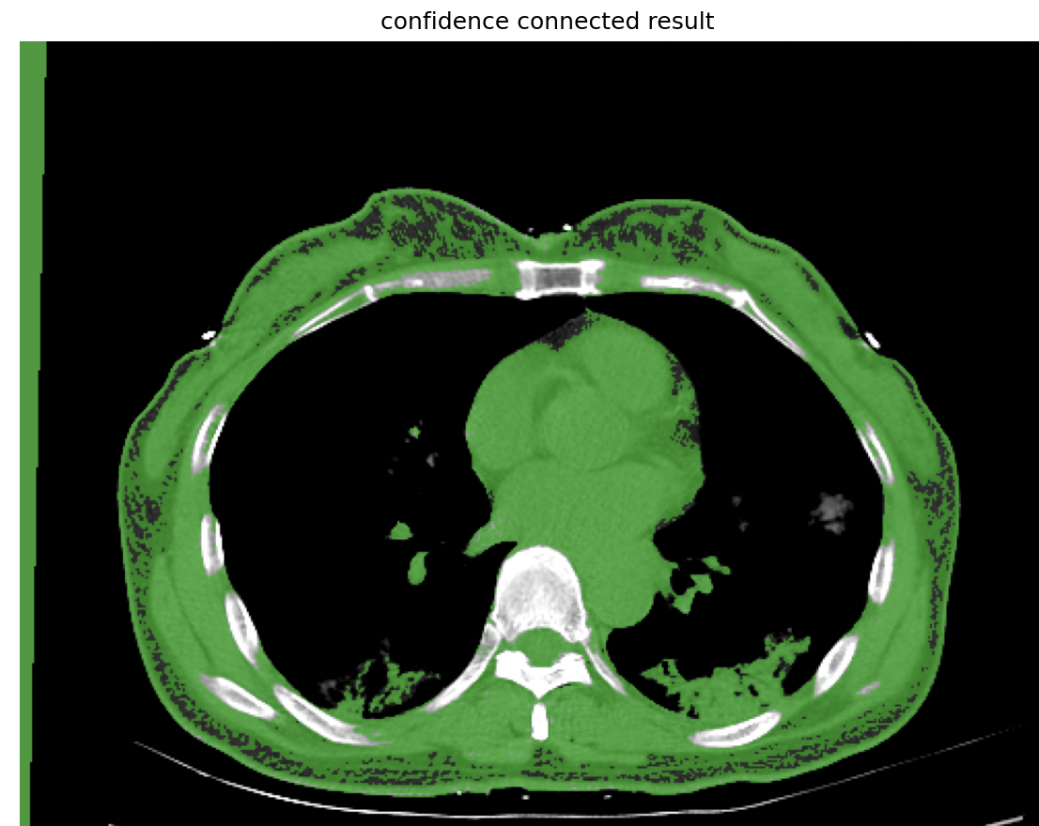
Quantification Continued
Region Growing Segmentation
Here we show the difference of two Multiplier index values of the Confidence-Connected Filter:

Slide 29
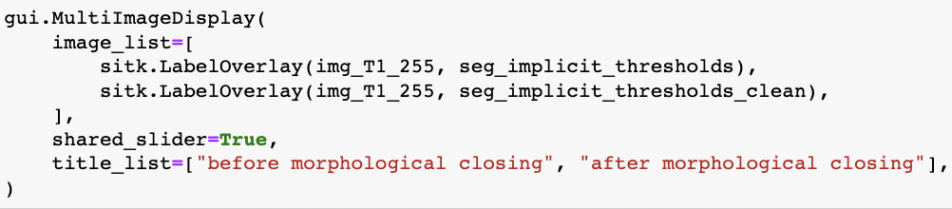
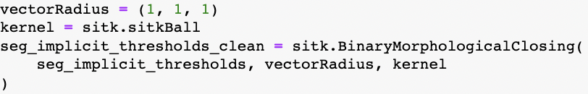
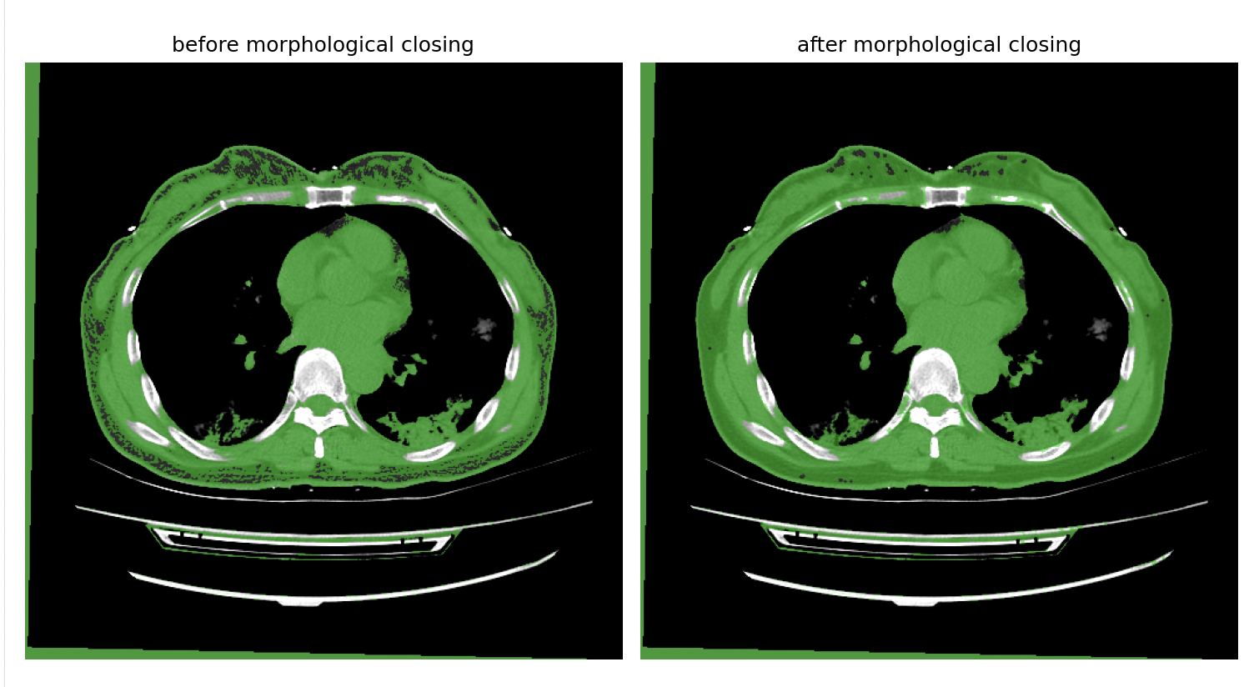
Quantification Continued
Region Growing Clean Up by implementing Closing process(Dilation then Erotion)

Slide 30
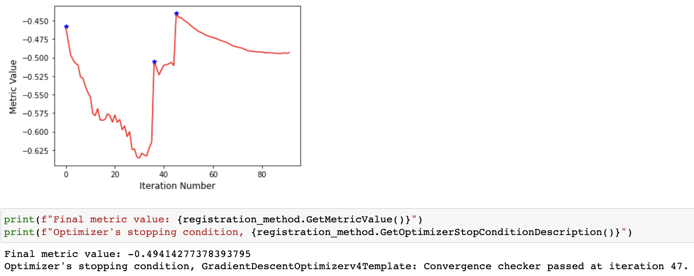
Quantification Continued
Validating Registration results Visually
Intensity Based Demon

Slide 31


Quantification Continued
Intensity Based Result: Demon Result:

Slide 32
Quantification Continued
Registration Evaluation:
The accuracy of nonrigid image registrations is commonly approximated using surrogate measures such as tissue label overlap scores, image similarity, image differences, or transformation inverse consistency error.
Quantifying the accuracy of nonrigid image registration is inherently difficult. Whereas a satisfactory gold standard database for evaluating the accuracy of rigid inter-modality registration of head images has been available for over a decade, no such gold standard yet exists for nonrigid registration.
Rigid registration accuracy is comparatively easy to quantify because the rigid registration error at any given point is completely determined by errors at three non-collinear landmarks.

Slide 33


Quantification Continued
Registration Evaluation:

Slide 34



Quantification Continued
Registration Evaluation:

Slide 35


Quantification Continued
Compare results:
Region Growing
Watershed

Slide 36


Quantification Continued
Registration Compare
Intensity Based
Demon

Slide 37
Thank You For Watching

